Slide 1

Capstone Project
EDA on Play Store App Reviews Team Members
Md Asad Alam (E-mail: mdasadalam354@gmail.com) (github: https://github.com/asadalam1/play_store_app_analysis) Ejaz Alam (E-mail: ejazalam9006@gmail.com) (github: https://github.com/EjazAlam9006/play-store-app-reveiw-analysis) Pranjal Jha (E-mail: sujeetkumarjha37@gmail.com) (https://github.com/pranjaljha25/play_store_data_analysi-EDA-)

Slide 2
Content
About the Project
Problem Statement
Factors Influencing an App’s Success
Data Summary
What percentage of applications are free and paid?
Count of apps in each category
Average Rating of Free and paid apps
Comparing no. of Installs and no. of apps available in Play Store by it’s Content Rating
Categories of apps that are getting installed the most
How does size impact the number of installs of any application
Top Revenue generated by Paid apps depending on its category
Drawing Correlation Heatmap
Distribution of type of reviews in the dataset
Analyzing Sentiment Polarity and Sentiment Subjectivity
Summary

Slide 3
About the Project
This is our first Capstone Project Play Store App Review Analysis. With this project we are implementing what we have learned during our first module.
The Play Store Apps data has enormous potential to drive app making business to success.
We have tried to extract actionable insight for developers to work on and capture the Android Apps Market.
Analysing the data of Play Store App Review can be used :
Understanding the present Android Apps Market
Understanding the users of Application
Business Decisions

Slide 4
Problem Statement
We were given two datasets, one with basic information and the other with user reviews data of respective applications.
We have to explore and analyze both the datasets in order to get the key factors responsible for application engagement and success.
Factors influencing an application success :
High average user rating,
Most number of positive reviews,
Size of application,
Which type does the application belongs free or paid

Slide 5
Data Summary
Play Store Apps Data:
App: Name of the application.
Category: Category in which they belong eg. Games, Tools , etc
Rating: Ranging from 1 to 5 , determines the quality of application.
Reviews: No of people rated the application.
Size: Device memory consumed by the application.
Installs: Number of installs the app witnessed.
Type: Paid or Free
Price: Cost of the application if it is paid.
Content Rating: Shows the app targeting which age group.
Genres: Sub category in which the app belong eg. Art & Design, Creativity, etc
Last Updated: The date on which the last update is rolled out for the application.
Current Version: The version of the app currently available.
Android Version: The version of Android on which the application is supported.

Slide 6
Data Summary(cont.)
User Reviews Data:
App: Name of the application.
Translated_Review: The review written by the user.
Sentiment: Thought point about the application (Positive or Negative)
Sentiment_Polarity: Float lies in the range [-1,1] , where 1 means positive sentiment and -1 means negative sentiment.
Sentiment_Subjectivity: Float lies in the range [0,1], higher subjectivity means the text contains more personal opinion rather than factual information.

Slide 7
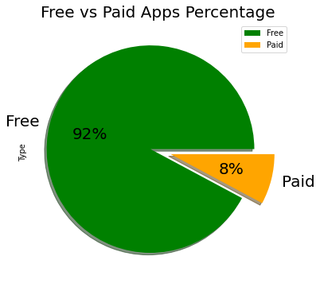
1) What percentage of applications are free and paid?
As we can clearly notice that almost 92% of apps are free in Play Store and only 8% of total apps lies in paid type.

Slide 8
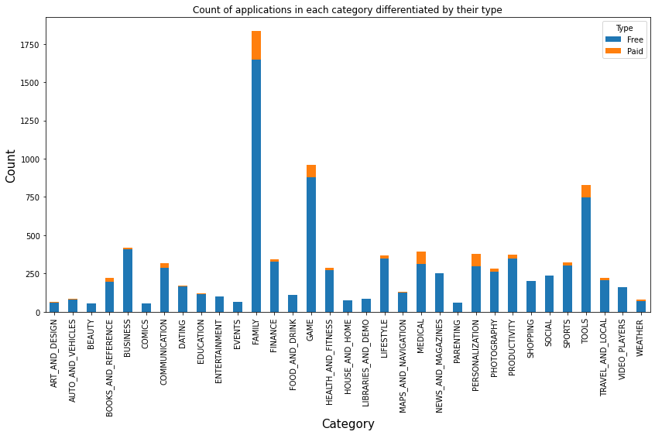
2) Count of apps in each category:
It looks like certain app categories have more free apps available for download than others. In our dataset, the majority of apps in Family, Games,Tools and Business are Free. At the same time Family, Medical, Games, Personalization and Tools had the most number of paid apps available for download.

Slide 9
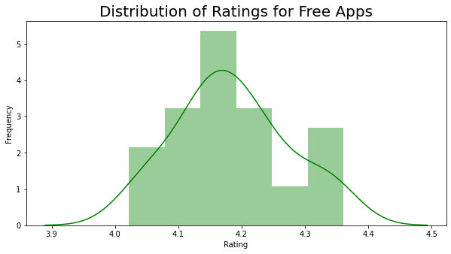
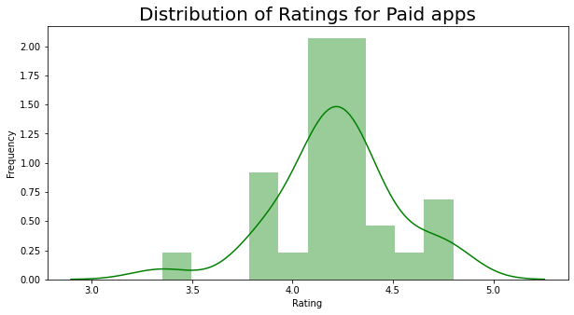
3) Average Rating of Free and paid apps.
On basis of average rating we can see that user experience of paid apps is slightly better than the free apps.
However there are some paid apps whose average rating is below 3.5 which isn’t the case with free apps.

Slide 10
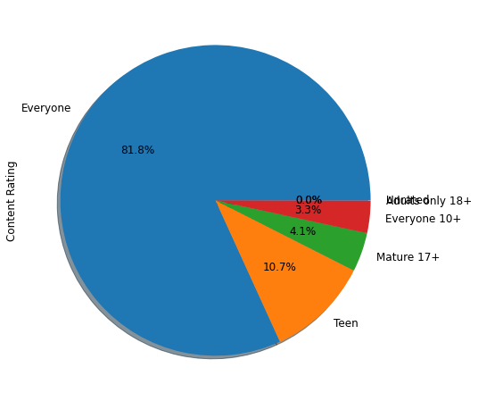
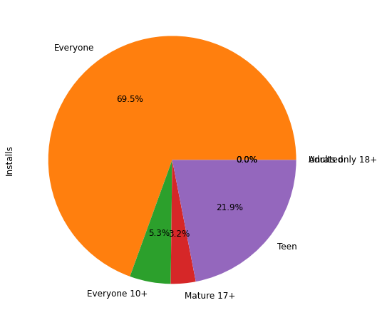
4) Comparing no. of Installs and no. of apps available in Play Store by its Content Rating
There are majority of apps available for Everyone followed by 10.7% of apps for Teens , 4% for Mature 17+ and 3.3% for 10+.
And there are very few apps available for Adults 18+ and Unrated.
We can notice that there are only 10.7% apps available for Teens but it accounts for 21% of total app installs, hence it is evident that demand of apps for Teens is very high

Slide 11
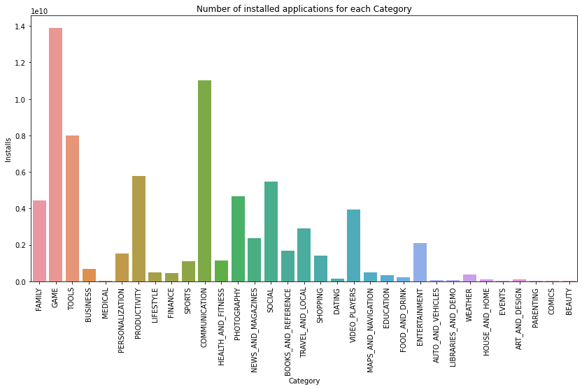
5) Categories of apps that are getting installed the most

Slide 12
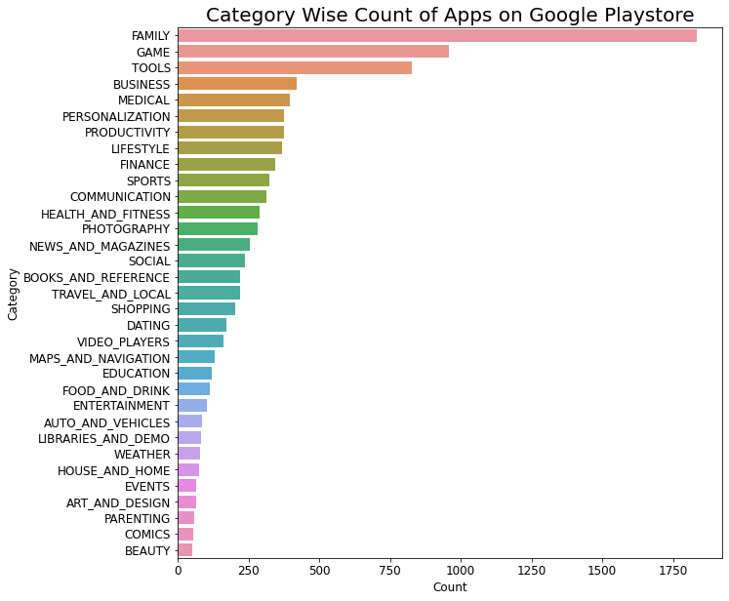
5)Categories of apps that are getting installed the most (Cont)
As we can see from the two plots: Maximum number of apps present in Google play store comes under Family, Games, Tools, and Business but as per the installation and requirement in the market plot, scenario is not the same. Maximum installed apps comes under Games, Communication, Tools and Productivity.
Here we can also see that no of apps available in Communication and Social category is very less as compared to user demands as its installs are very high.

Slide 13
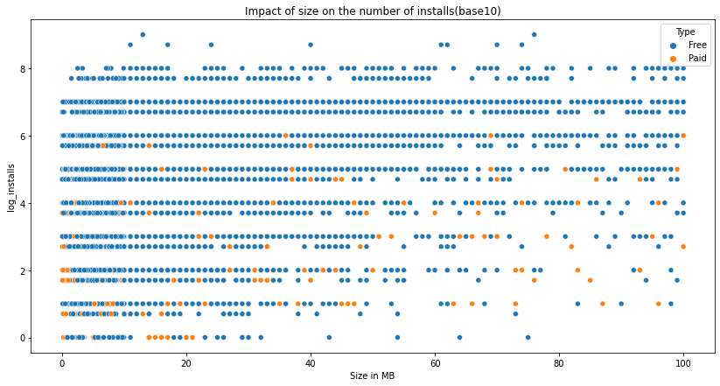
6) How does size impact the number of installs of any application:
It is clear from the above mentioned plot that size may impact the number of installations. Bulky applications are less installed by the user.

Slide 14
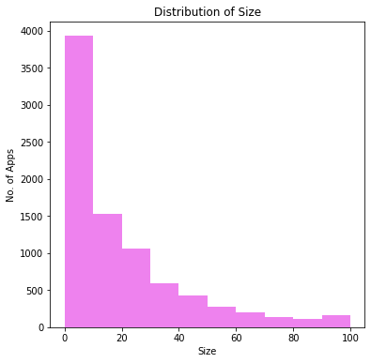
6) How does size impact the number of installs of any application: (cont.)
Majority of apps in the Play Store are of size less than 20MB.
As we move further in Size axis the no. of apps drastically goes down.

Slide 15
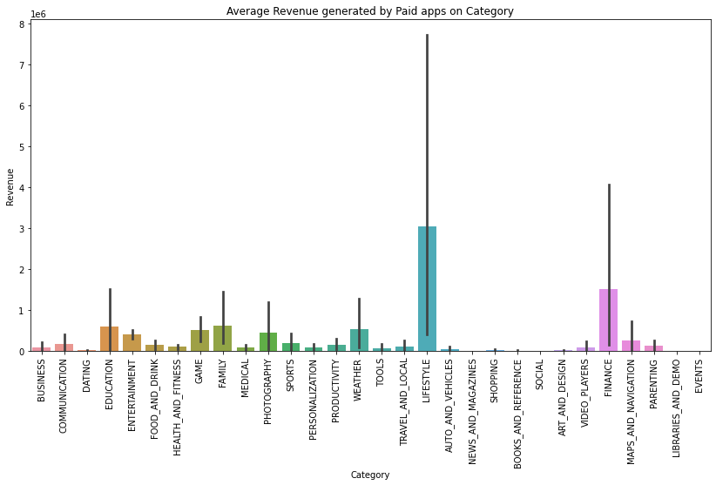
7) Top Revenue generated by Paid apps depending on its category
Here we can see that Lifestyle Category has generated the highest average revenue followed by Finance, Family and Education.

Slide 16
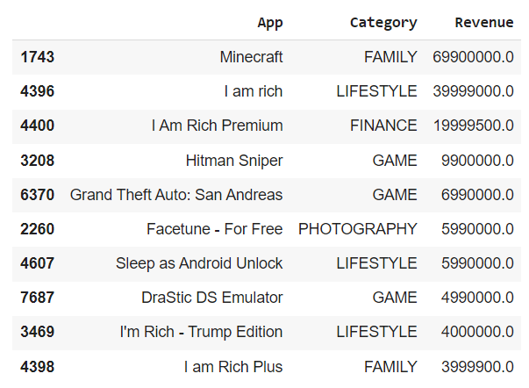
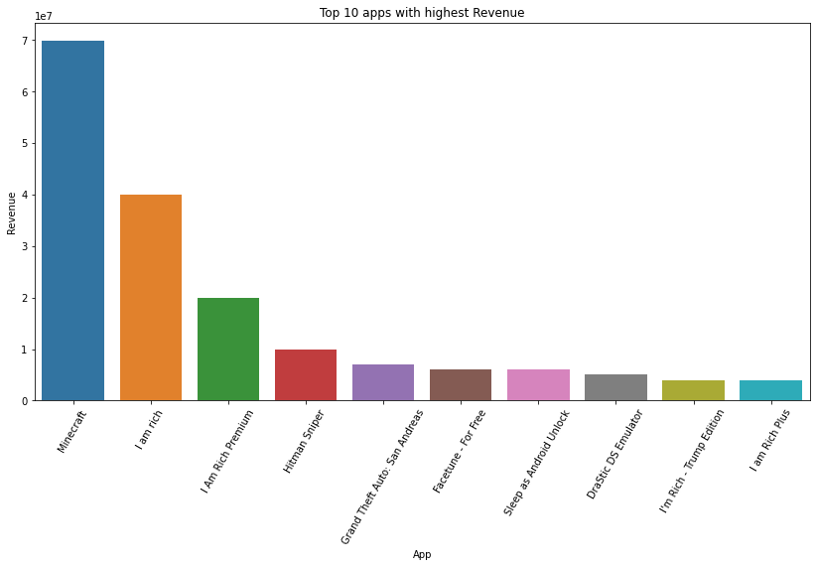
7) Top Revenue generated by Paid apps depending on its category (cont.)
These are the top 10 apps which have generated the highest revenue .

Slide 17
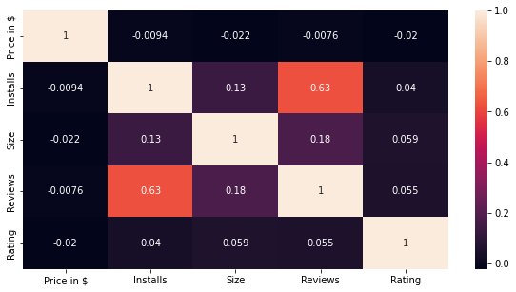
8 ) Drawing Correlation Heatmap
We can see that there is a strong positive correlation between Reviews and Installs, More the app is being installed the more it will be reviewed.
Also there is light positive correlation between Installs and Size, As People tend to install apps which consumes less memory in their device.
Price is slightly negatively correlated with Rating, Review, Size and Installs.
Rating is slightly positively correlated with Installs, Size and Reviews.

Slide 18
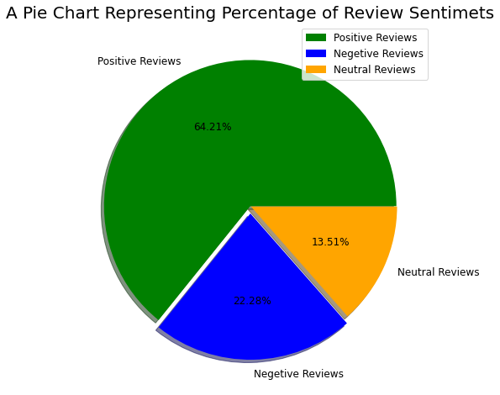
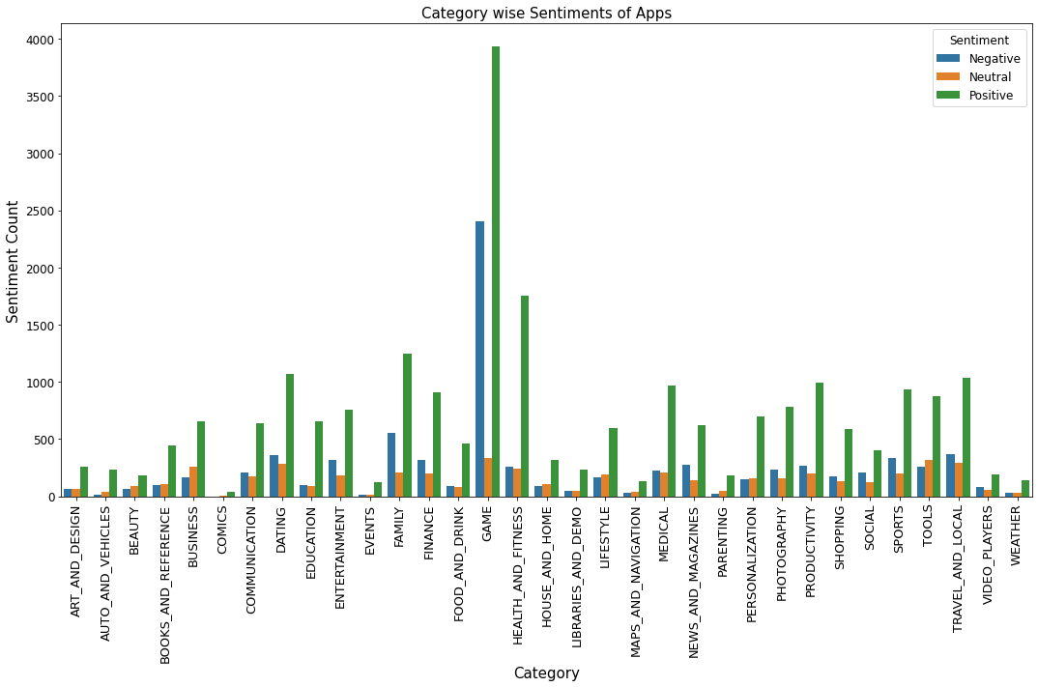
9) Distribution of type of reviews in the dataset
Majority of the apps (64.2%) in the Play Store is Positively Reviewed and 22.2% are Negatively Reviewed and the rest 13.5% are Neutral Reviewed.
Looking Category wise Games has both highest Positive Review and Negative Review at the same time.

Slide 19
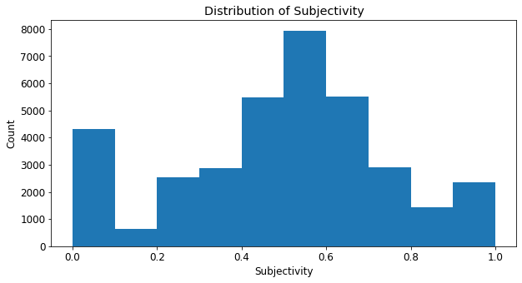
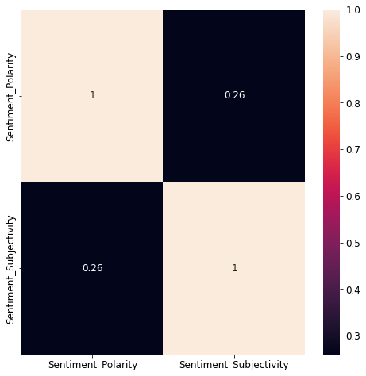
10 ) Analyzing Sentiment Polarity and Sentiment Subjectivity:
It can be seen that maximum number of sentiment subjectivity lies between 0.4 to 0.7. From this we can conclude that maximum number of users give reviews to the applications, according to their experience and is not factual.
From the above Heatmap it can be concluded that sentiment subjectivity is not always correlated to sentiment polarity .

Slide 20
Summary
Majority of the apps in the Play Store is Free (~92%).
Family, Games, Tools, and Business Category holds the major chunk of apps in the Play Store.
Most competitive category is Family and Games.
Category of Apps getting installed the most is Games, Communication, and Tools.
Demands of the Communication Category apps is higher .
Lifestyle Category has generated the highest revenue through installs.
Percentage of apps with no age restriction is ~82%
Only 11% of apps are available for Teens but it accounts for 21% of total app installs.
Minecraft app has generated the highest revenue of ~69Million$ with over ~10Million installs.
Average Rating of Paid apps is 4.2 and for Free apps is 4.1 .
Bulky apps are less installed by the user.
Majority of the apps in the Play Store are of size less than 20MB.
There is a strong positive correlation between Reviews and Installs.
Price is negatively correlated with Installs.
Majority of the apps (64.2%) in the Play Store is Positively Reviewed.
Sentiment Subjectivity is not correlated with Sentiment Polarity.

Slide 21
Thank You…

